Slide 1
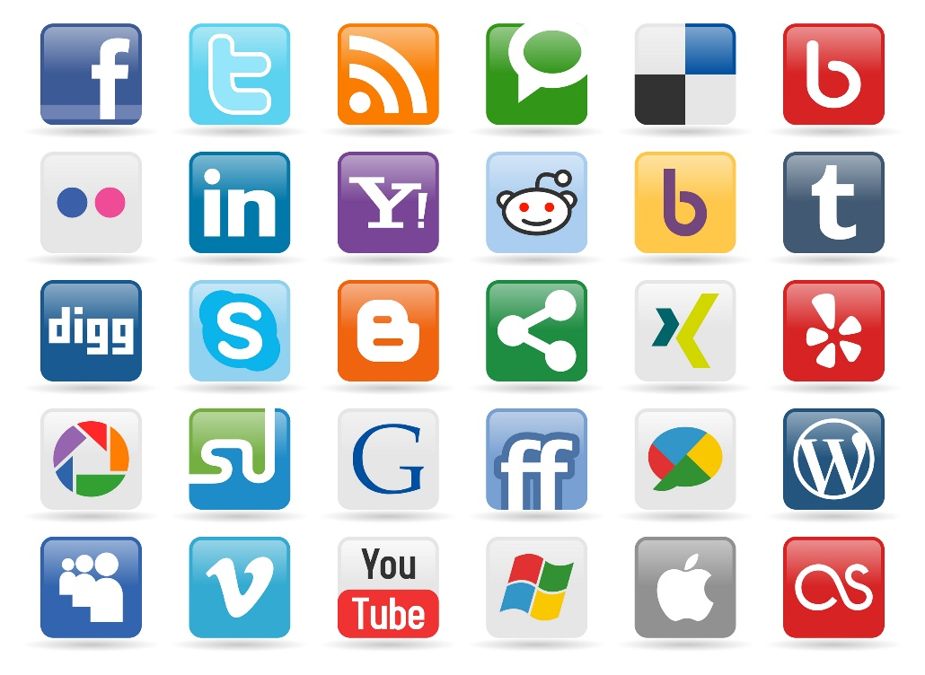

Influence and Homophily
SOCIAL
MEDIA
MINING

Slide 2
Dear instructors/users of these slides: Please feel free to include these slides in your own material, or modify them as you see fit. If you decide to incorporate these slides into your presentations, please include the following note:
R. Zafarani, M. A. Abbasi, and H. Liu, Social Media Mining: An Introduction, Cambridge University Press, 2014.
Free book and slides at http://socialmediamining.info/
or include a link to the website: http://socialmediamining.info/

Slide 3
Social Forces
Social Forces connect individuals in different ways
When individuals get connected, we observe distinguishable patterns in their connectivity networks.
Assortativity, also known as social similarity
In networks with assortativity:
Similar nodes are connected to one another more often than dissimilar nodes.
Social networks are assortative
A high similarity between friends is observed
We observe similar behavior, interests, activities, or shared attributes such as language among friends

Slide 4

Why are connected people similar?
Influence
The process by which a user (i.e., influential) affects another user
The influenced user becomes more similar to the influential figure.
Example: If most of our friends/family members switch to a cellphone company, we might switch [i.e., become influenced] too.
Homophily
Similar individuals becoming friends due to their high similarity
Example: Two musicians are more likely to become friends.
Confounding
The environment’s effect on making individuals similar
Example: Two individuals living in the same city are more likely to become friends than two random individuals
Notes:
@inproceedings{anagnostopoulos2008influence, title={Influence and correlation in social networks}, author={Anagnostopoulos, A. and Kumar, R. and Mahdian, M.}, booktitle={Proceeding of the 14th ACM SIGKDD international conference on Knowledge discovery and data mining}, pages={7--15}, year={2008}, organization={ACM} }

Slide 5
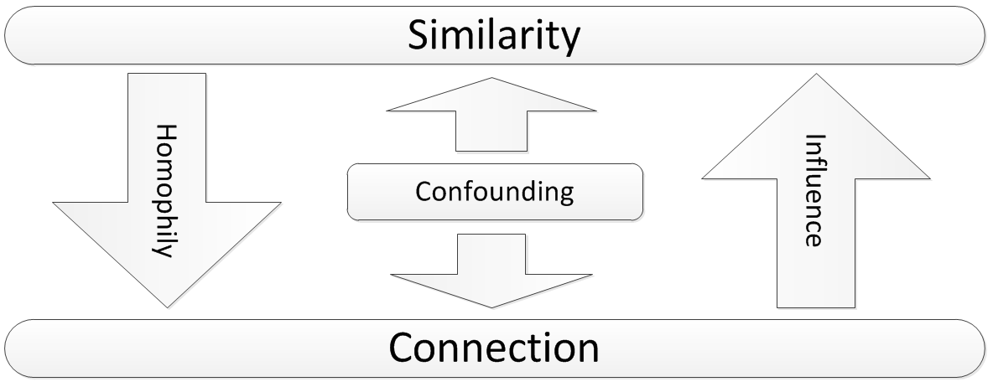
Influence, Homophily, and Confounding

Slide 6
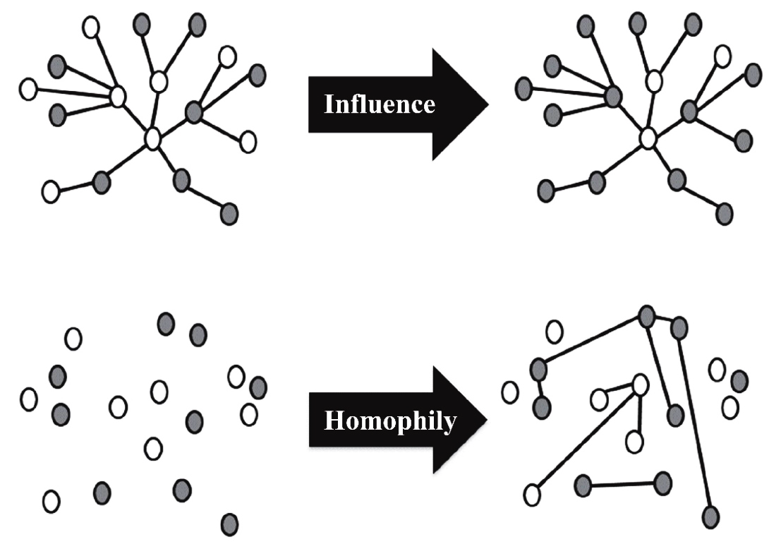
Source of Assortativity in Networks
Both influence and Homophily generate similarity in social networks
Influence
Makes connected nodes similar to each other
Homophily
Selects similar nodes and links them together

Slide 7
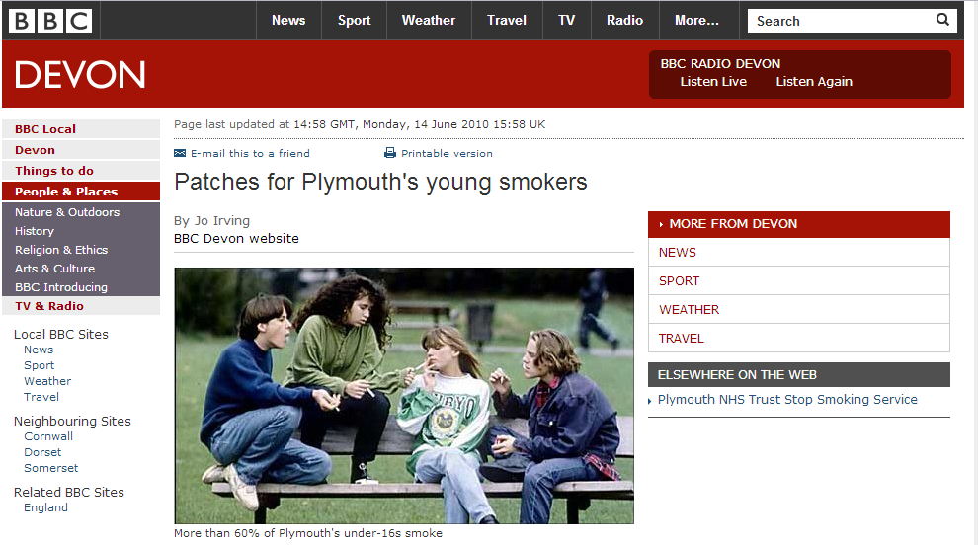
Assortativity Example
The city's draft tobacco control strategy says more than 60% of under-16s in Plymouth smoke regularly
Notes:
http://news.bbc.co.uk/local/devon/hi/people_and_places/newsid_8738000/8738850.stm

Slide 8
Why?
Smoker friends influence their non-smoker friends
Smokers become friends
Can this explain smoking behavior?
There are lots of places that people can smoke
Influence
Homophily
Confounding

Slide 9
Our goal?
How can we measure assortativity?
How can we measure influence or homophily?
How can we model influence or homophily?
How can we distinguish between the two?

Slide 10
Measuring Assortativity

Slide 11
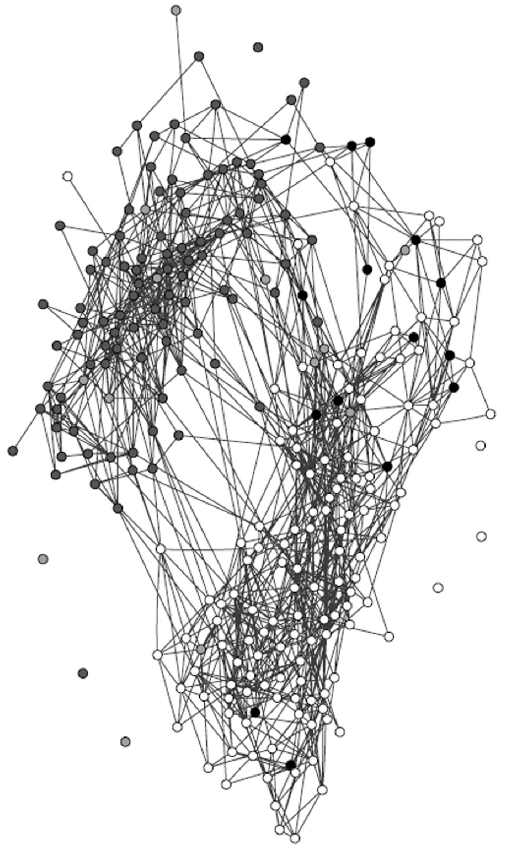
Assortativity: An Example
The friendship network in a US high school in 1994
Colors represent races,
White: whites
Grey: blacks
Light Grey: hispanics
Black: others
High assortativity between individuals of the same race

Slide 12
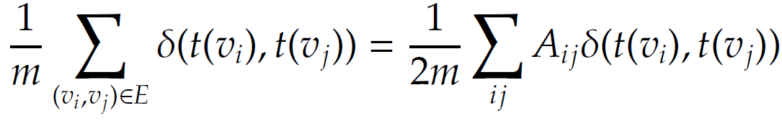
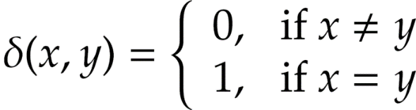
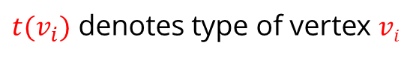
Measuring Assortativity for Nominal Attributes
Assume nominal attributes are assigned to nodes
Example: race
Edges between nodes of the same type can be used to measure assortativity of the network
Same type = nodes that share an attribute value
Node attributes could be nationality, race, sex, etc.
$t(v_{i})$ denotes type of vertex $vi$
Kronecker delta function

Slide 13
Assortativity Significance
Assortativity significance
The difference between measured assortativity and expected assortativity
The higher this difference, the more significant the assortativity observed
Example
In a school, 50% of the population is white and the other 50% is hispanic.
We expect 50% of the connections to be between members of different races.
If all connections are between members of different races, then we have a significant finding

Slide 14
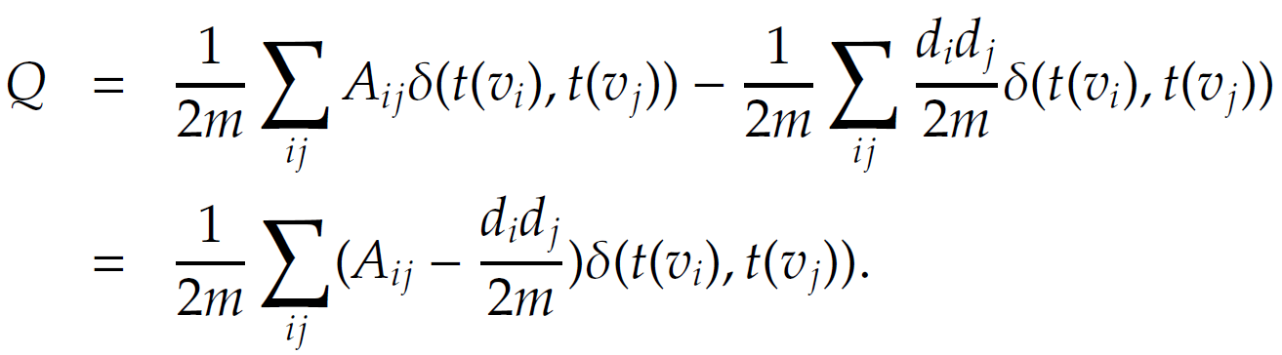
Assortativity Significance
Assortativity
Expected assortativity
(according to configuration model)
This is modularity

Slide 15
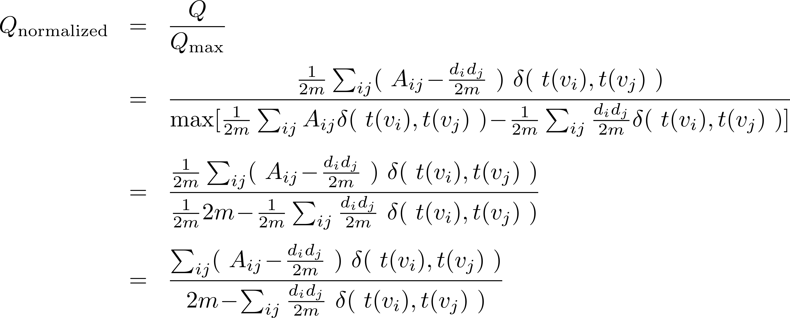
Normalized Modularity [Finding the Maximum]
The maximum happens when all vertices of the same type are connected to one another
Notes:
For the max function in the denominator, iif there is an edge between two nodes, their types are the same.

Slide 16
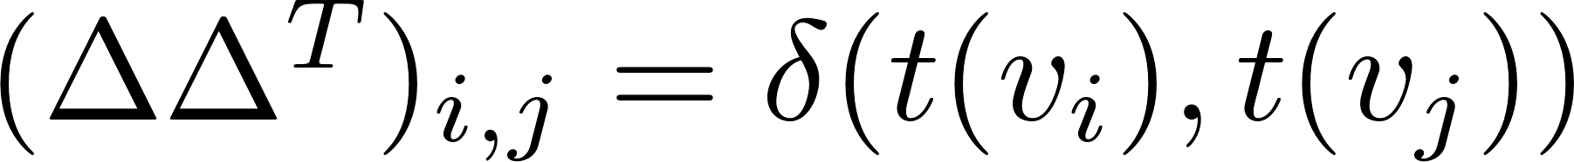
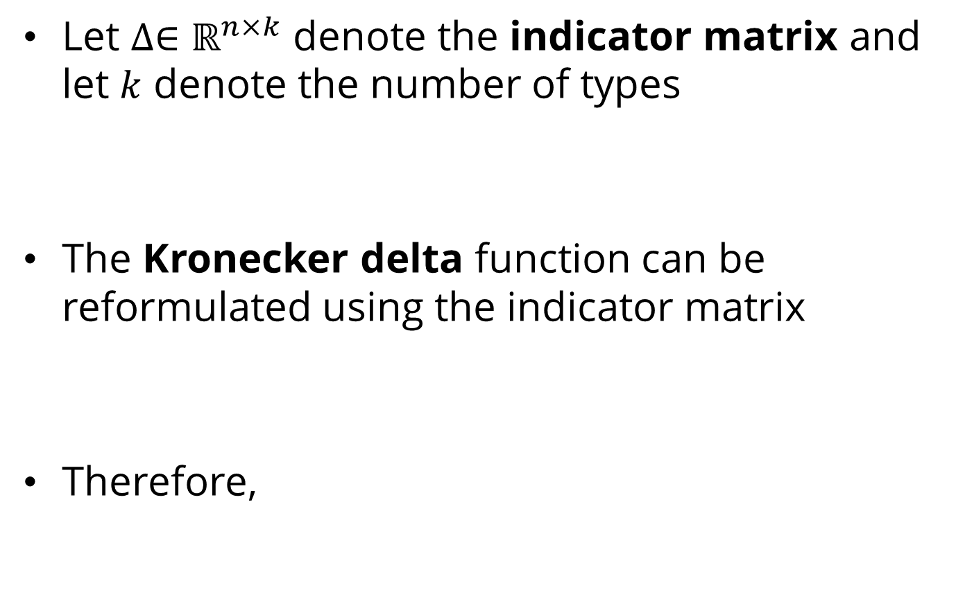
Modularity: Matrix Form
Let $∆∈ℝ^{n×k}$ denote the indicator matrix and let $k$ denote the number of types
The Kronecker delta function can be reformulated using the indicator matrix
Therefore,

Slide 17
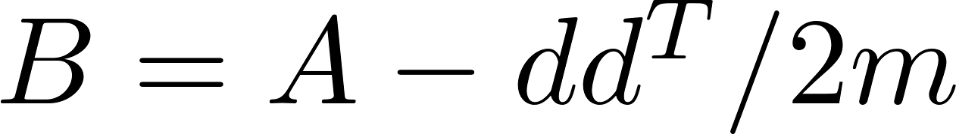
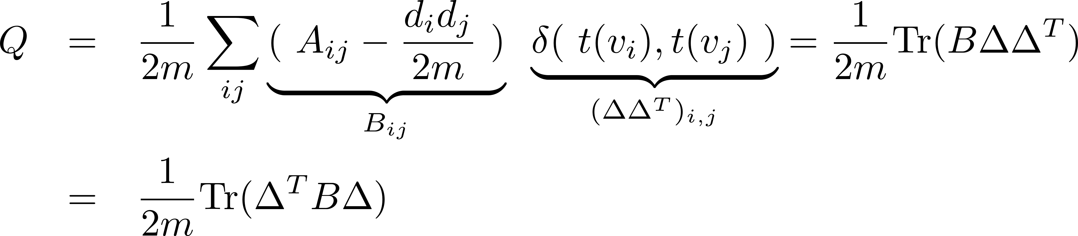
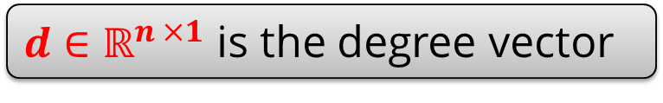
Normalized Modularity: Matrix Form
Let Modularity matrix be
$d∈ℝ^{n ×1}$ is the degree vector
Modularity can be reformulated as

Slide 18
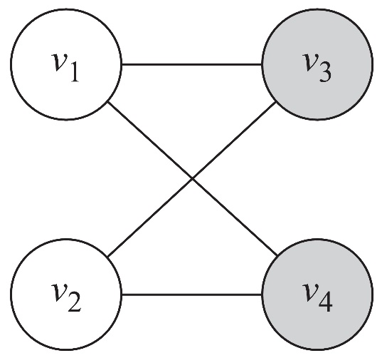
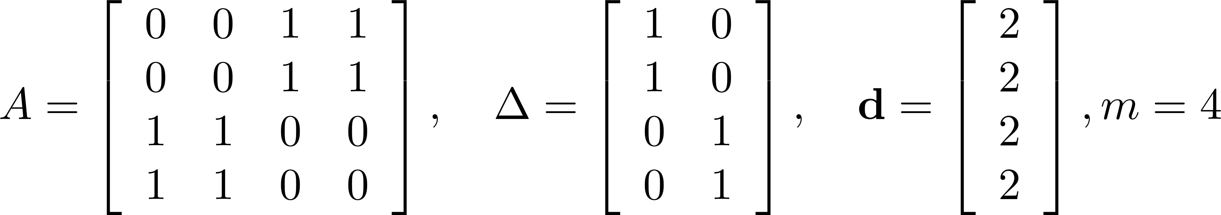
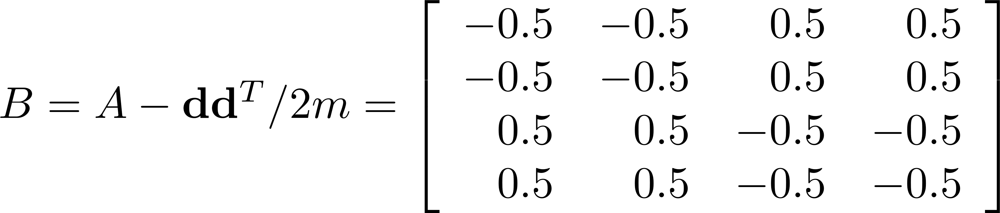
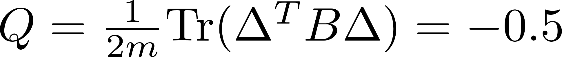
Modularity Example
The number of edges between nodes of the same color is less than the expected number of edges between them

Slide 19
Measuring Assortativity for Ordinal Attributes
A common measure for analyzing the relationship between ordinal values is covariance
It describes how two variables change together
In our case, we have a network
We are interested in how values assigned to nodes that are connected (via edges) are correlated

Slide 20
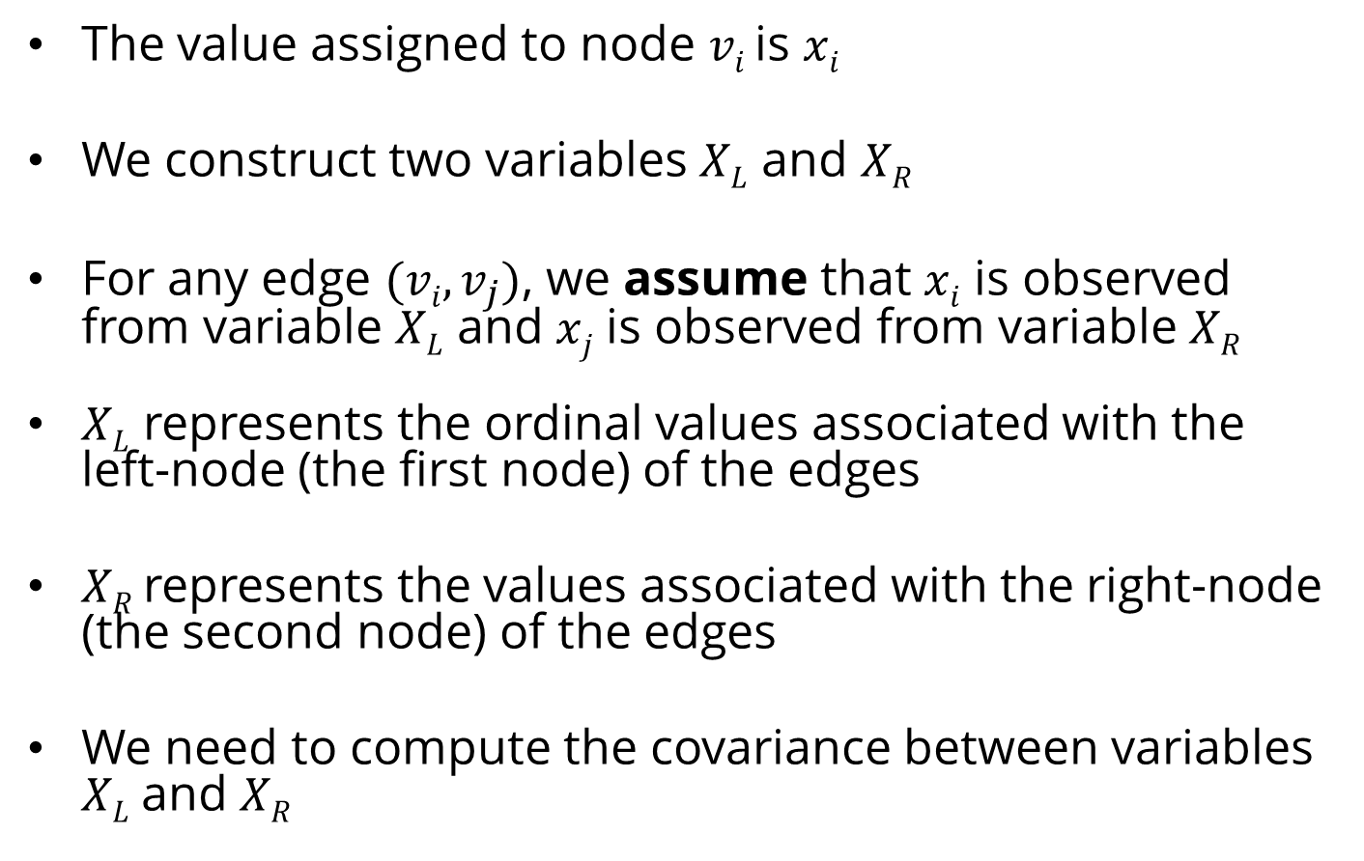
Covariance Variables
The value assigned to node $vi$ is $xi$
We construct two variables $XL$ and $XR$
For any edge $(vi,v_{j})$, we assume that $xi$ is observed from variable $XL$ and $xj$ is observed from variable $XR$
$XL$ represents the ordinal values associated with the left-node (the first node) of the edges
$XR$ represents the values associated with the right-node (the second node) of the edges
We need to compute the covariance between variables $XL$and $XR$

Slide 21
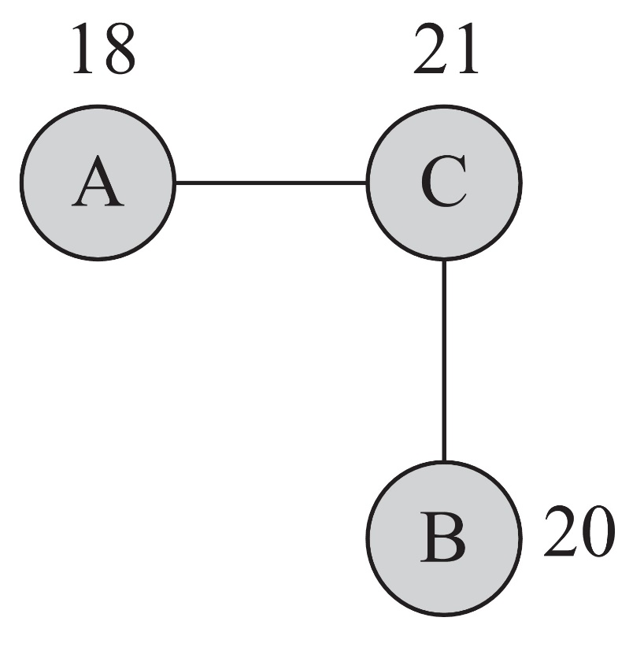
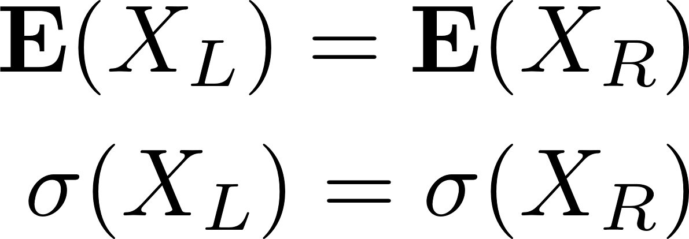
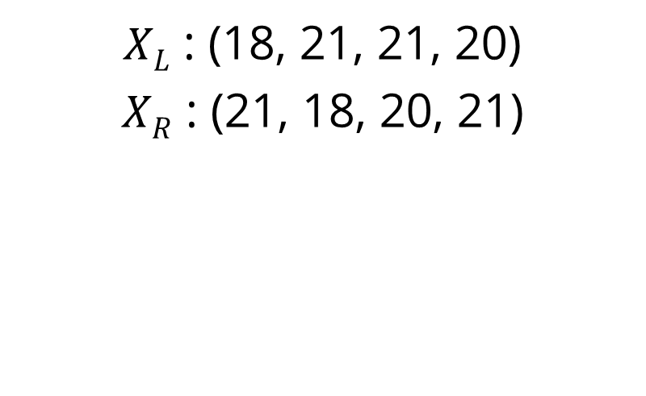
Covariance Variables: Example
List of edges:
(A, C)
(C, A)
(C, B)
(B, C)
$XL$ : (18, 21, 21, 20)
$XR$ : (21, 18, 20, 21)

Slide 22
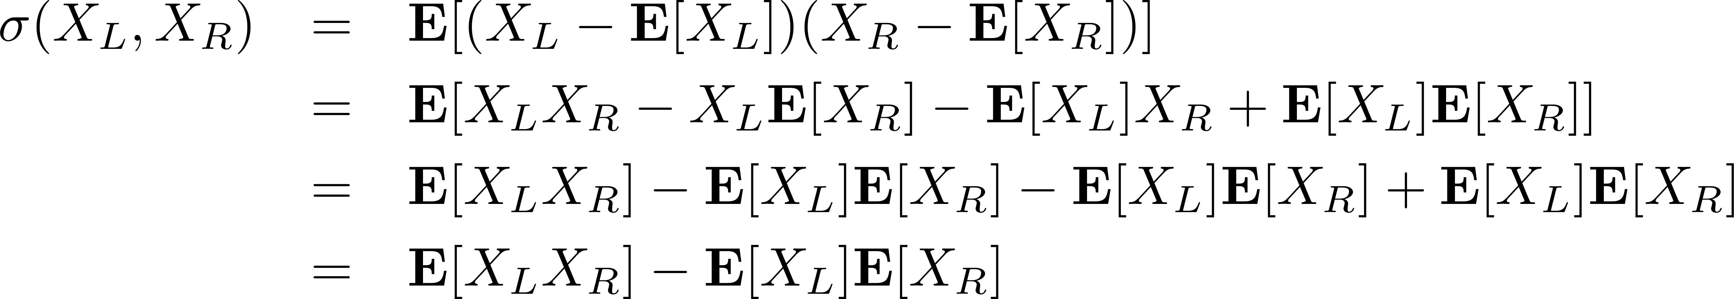
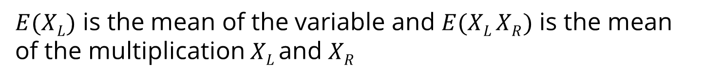
Covariance
For two given column variables $XL$ and $XR$ the covariance is
$E(XL)$ is the mean of the variable and $E(XL XR)$ is the mean of the multiplication $XL$and $XR$

Slide 23
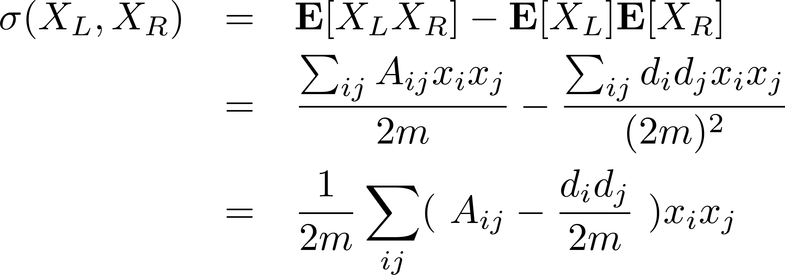
Covariance

Slide 24
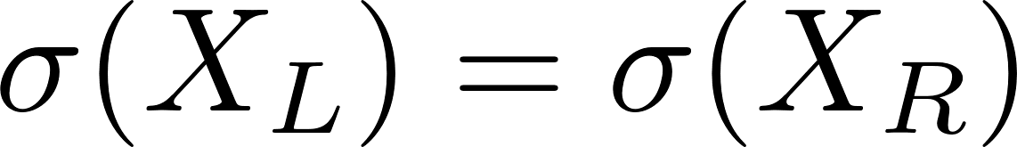
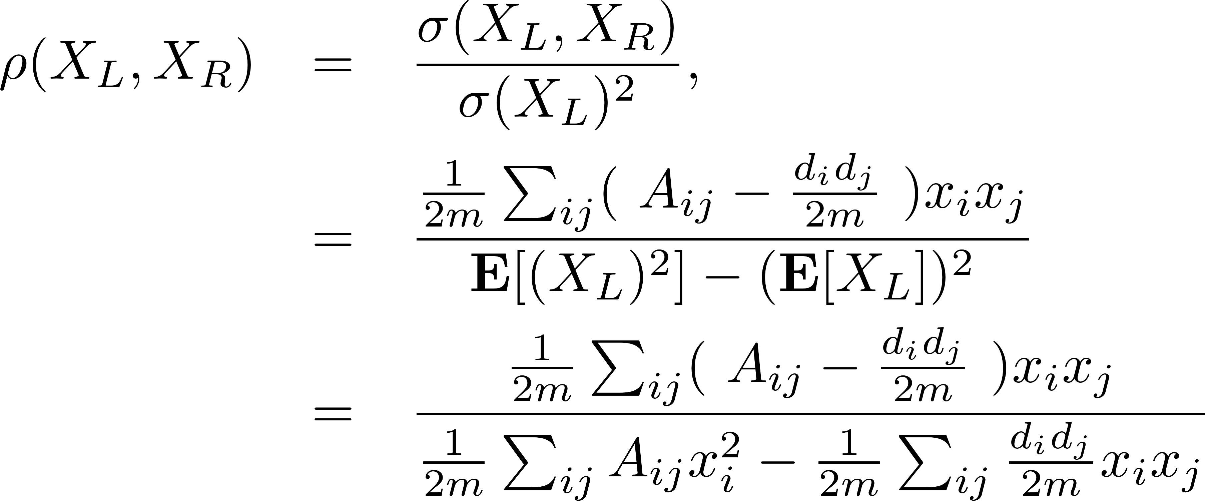
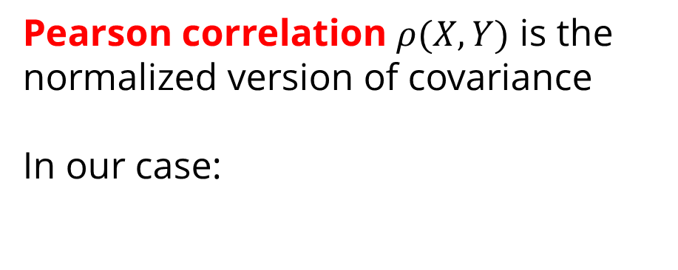
Normalizing Covariance
Pearson correlation $ρ(X,Y)$ is the normalized version of covariance
In our case:
Notes:
\sigma = E(X-E(X))^2

Slide 25
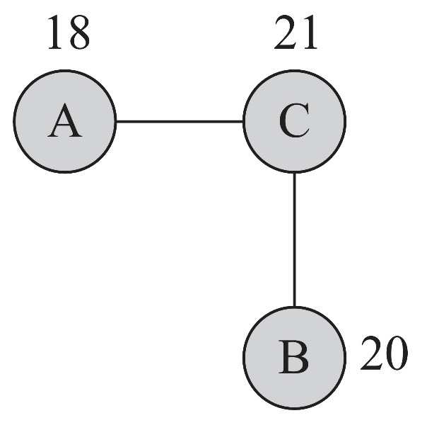
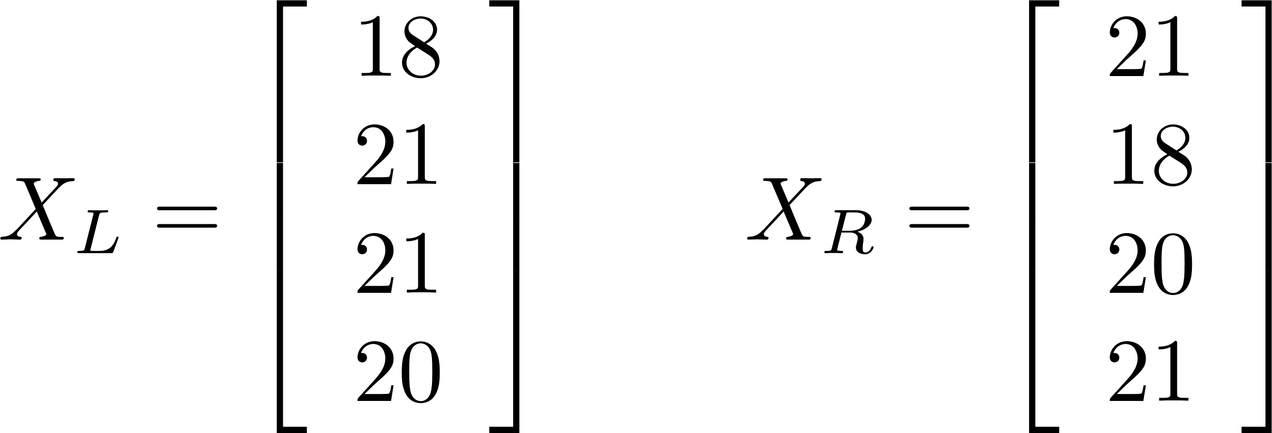
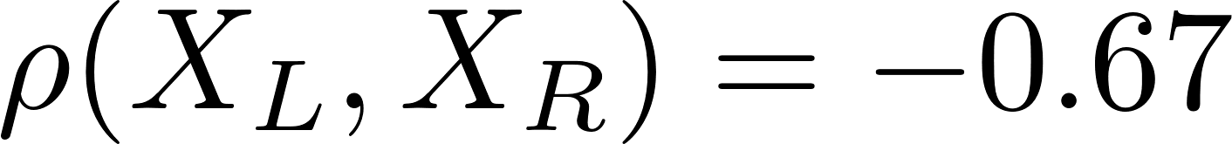
Correlation Example

Slide 26
Influence
Measuring Influence
Modeling Influence

Slide 27

Influence: Definition
Influence
The act or power of producing an effect without apparent exertion of force or direct exercise of command

Slide 28
Measuring Influence

Slide 29
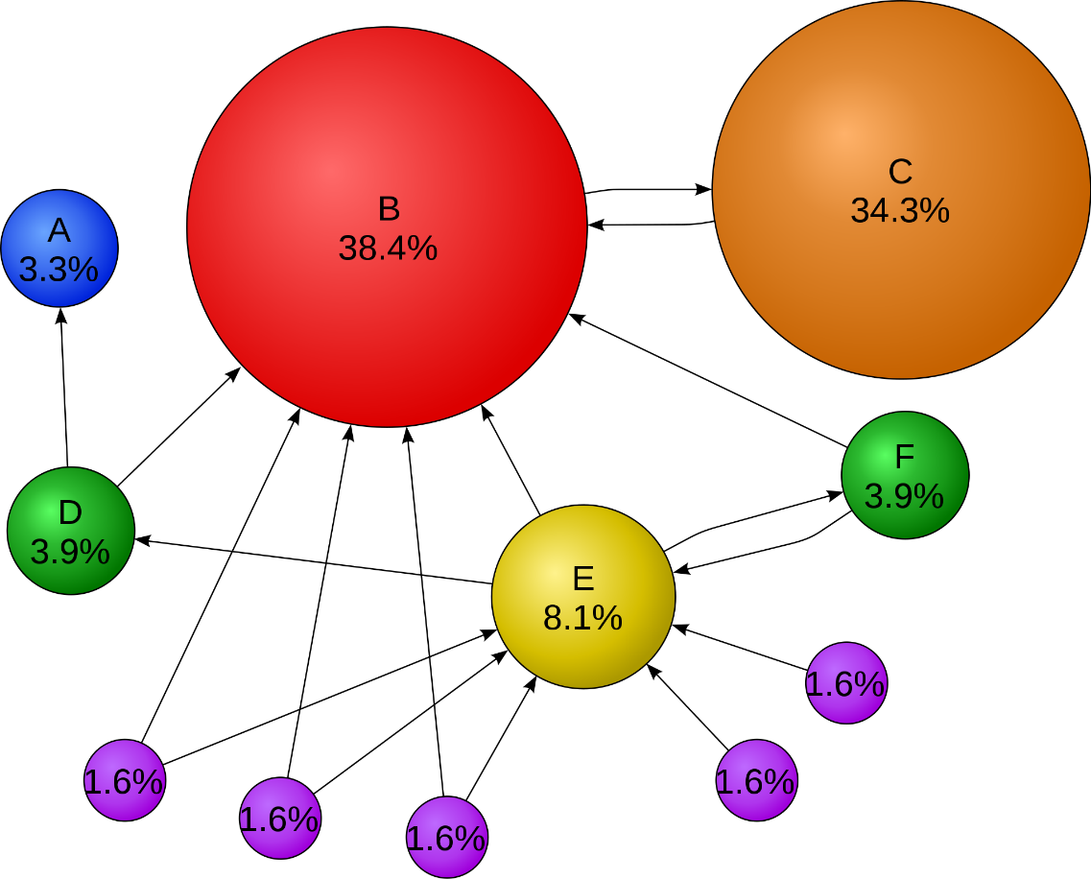
Measuring Influence
Measuring influence
Assigning a number (or a set of numbers) to each node that represents the influential power of that node
The influence can be measured based on
Prediction or
Observation

Slide 30
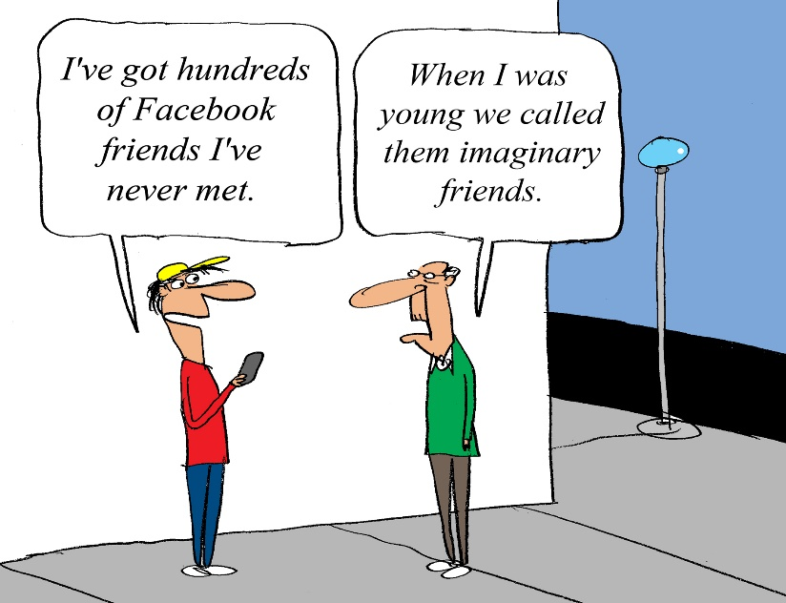
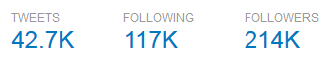
Prediction-based Measurement
We assume that
an individual’s attribute, or
the way the user is situated in the network
predicts how influential the user will be
Example 1:
We can assume that the number of friends of an individual is correlated with how influential she will be
It is natural to use any of the centrality measures discussed (Chapter 3) for prediction-based influence measurements
How strong are these friendships?
Example 2:
On Twitter, in-degree (number of followers) is a benchmark for measuring influence commonly used

Slide 31
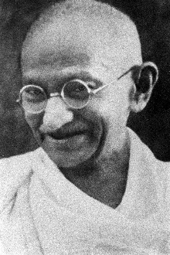


Observation-based Measurement
We quantify influence of an individual by measuring the amount of influence attributed to the individual
I. When an individual is the role model
Influence measure: size of the audience that has been influenced
II. When an individual spreads information
Influence measure: the size of the cascade, the population affected, the rate at which the population gets influenced
III. When an individual increases values
Influence measure: the increase (or rate of increase) in the value of an item or action
The second person who bought the fax machine increased its value dramatically

Slide 32
Case Studies for Measuring Influence in Social Media
Measuring Influence on Blogosphere
Measuring Influence on Twitter

Slide 33
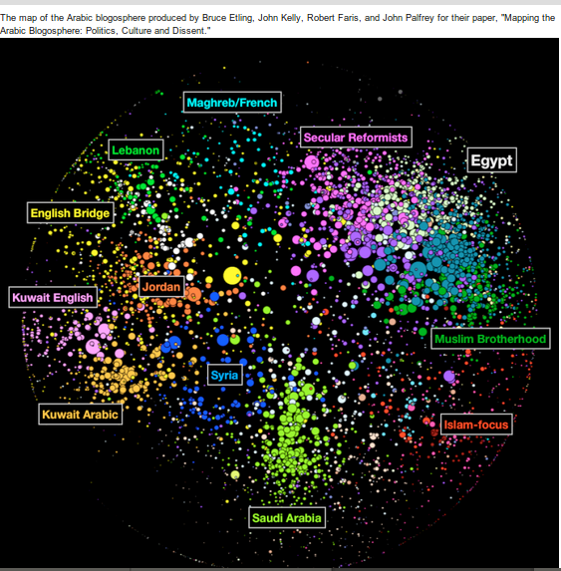
Measuring Social Influence on Blogosphere
Goal: figure out most influential bloggers on the blogosphere
Why? We have limited time
Following the influentials is often a good heuristic of filtering what’s uninteresting
Common measure for quantifying influence of bloggers is to use in-degree centrality
In-links are sparse
More detailed analysis is required to measure influence
Notes:
(Indegree is the number (in-)links that point to the blog)

Slide 34

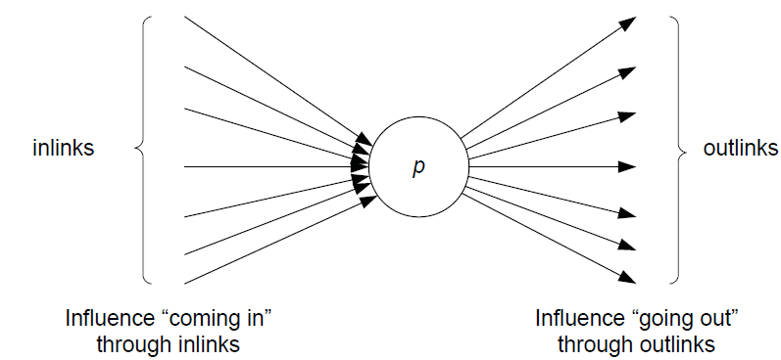
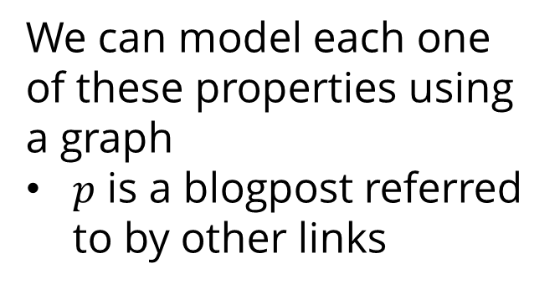
iFinder: Characterizing Influence in Blogs
Keller and Berry argue that the influentials are
Recognized by others [Recognition]
Their activities result in follow-up activities [Activity Generation]
Have novel perspectives [Novelty]
Are eloquent [Eloquence]
We can model each one of these properties using a graph
$p$ is a blogpost referred to by other links
Notes:
Nitin Agarwal’s WSDM2008 work

Slide 35
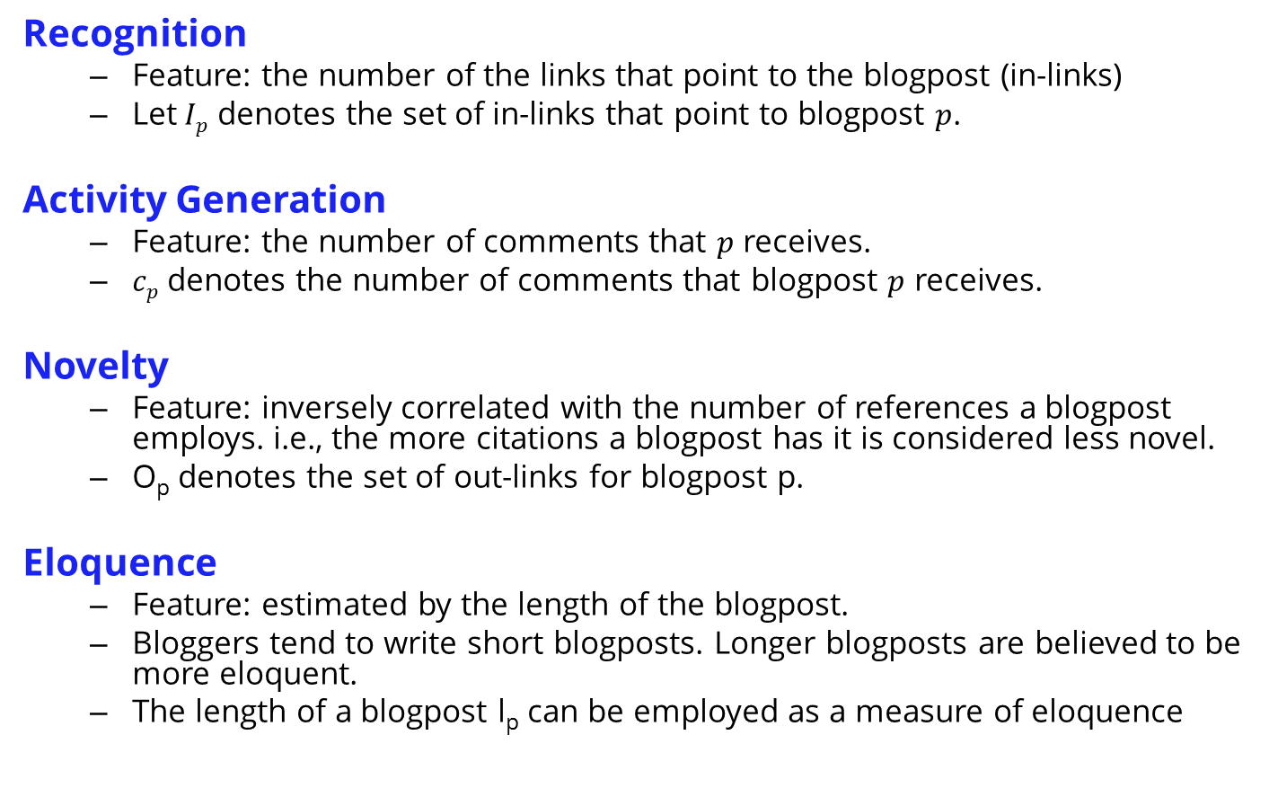
Social Gestures [Features for a Blogpost]
Recognition
Feature: the number of the links that point to the blogpost (in-links)
Let$Ip$ denotes the set of in-links that point to blogpost $p$.
Activity Generation
Feature: the number of comments that $p$ receives.
$cp$ denotes the number of comments that blogpost $p$ receives.
Novelty
Feature: inversely correlated with the number of references a blogpost employs. i.e., the more citations a blogpost has it is considered less novel.
O_{p} denotes the set of out-links for blogpost p.
Eloquence
Feature: estimated by the length of the blogpost.
Bloggers tend to write short blogposts. Longer blogposts are believed to be more eloquent.
The length of a blogpost l_{p} can be employed as a measure of eloquence

Slide 36
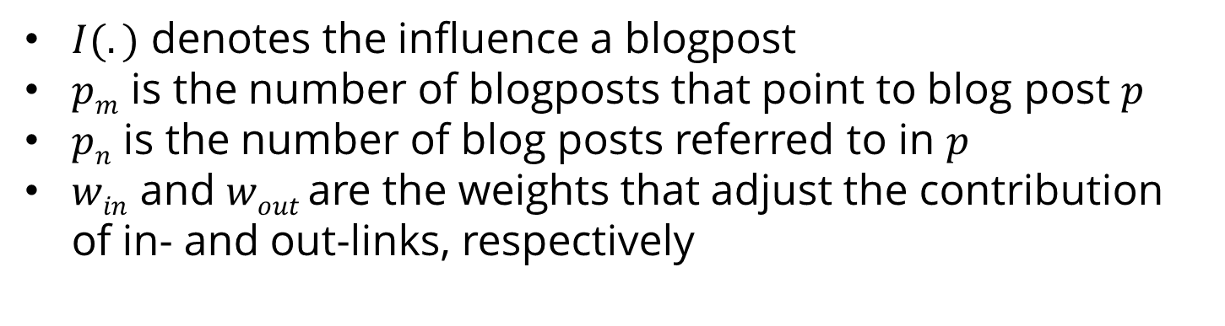
Influence Flow
Influence flow describes a measure that accounts for in-links (recognition) and out-links (novelty).
$I(.)$ denotes the influence a blogpost
$pm$ is the number of blogposts that point to blog post $p$
$pn$ is the number of blog posts referred to in $p$
$win$ and $wout$ are the weights that adjust the contribution of in- and out-links, respectively

Slide 37
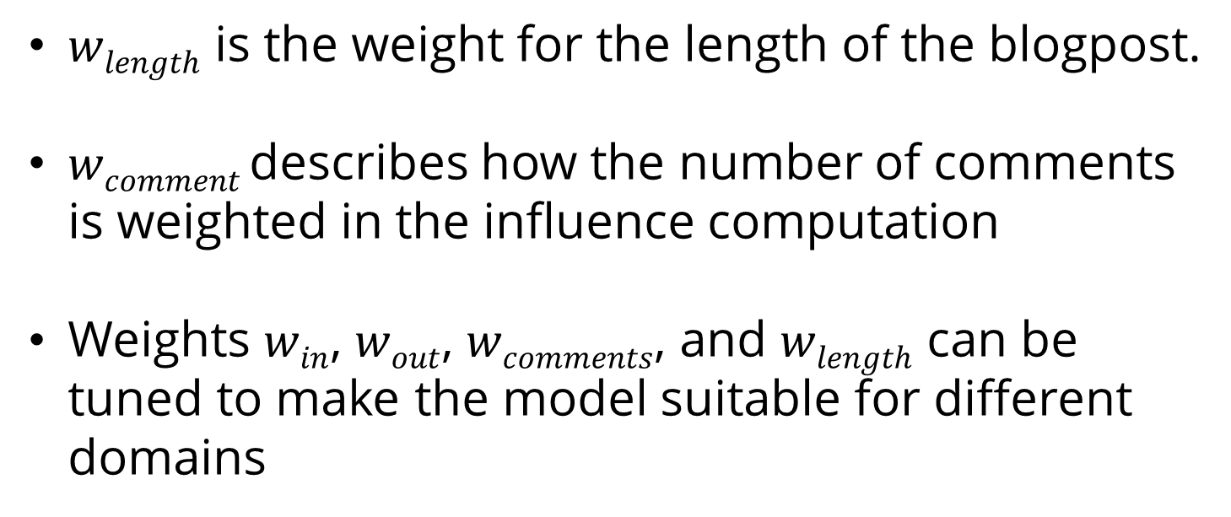
Blogpost Influence
$wlength$ is the weight for the length of the blogpost.
$wcomment$ describes how the number of comments is weighted in the influence computation
Weights $win$, $wout$, $wcomments$, and $wlength$ can be tuned to make the model suitable for different domains

Slide 38
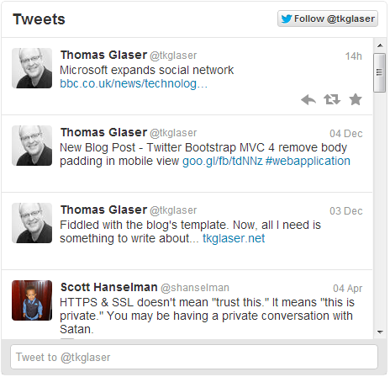
Measuring Social Influence on Twitter
In Twitter, users have an option of following individuals, which allows users to receive tweets from the person being followed
Intuitively, one can think of the number of followers as a measure of influence (in-degree centrality)

Slide 39
Measuring Social Influence on Twitter: Measures
In-degree
The number of users following a person on Twitter
Indegree denotes the “audience size” of an individual.
Number of Mentions
The number of times an individual is mentioned in a tweet, by including @username in a tweet.
The number of mentions suggests the “ability in engaging others in conversation”
Number of Retweets
Twitter users have the opportunity to forward tweets to a broader audience via the retweet capability.
The number of retweets indicates individual’s ability in generating content that is worth being passed on.

Slide 40
Measuring Social Influence on Twitter: Measures
Each one of these measures by itself can be used to identify influential users in Twitter.
We utilizing the measure for each individual and then rank users based on their measured influence value.
Observation: contrary to public belief, number of followers is considered an inaccurate measure compared to the other two.
We can rank individuals on twitter independently based on these three measures.
To see if they are correlated or redundant, we can compare ranks of an individuals across three measures using rank correlation measures.

Slide 41
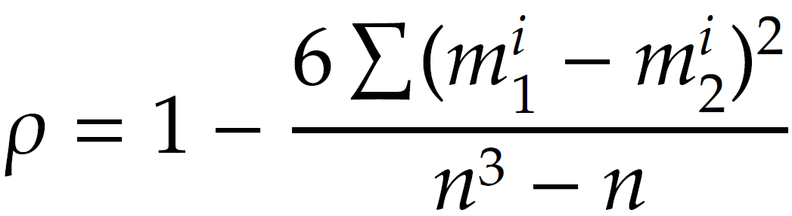
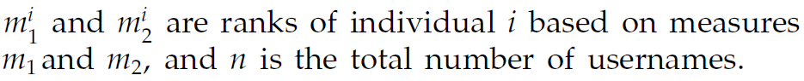
Comparing Ranks Across Three Measures
To compare ranks across more than one measure (say, in-degree and mentions), we can use Spearman’s Rank Correlation Coefficient
Notes:
Indegrees vs. mentions, mentions vs. retweets, retweets vs. indegrees

Slide 42
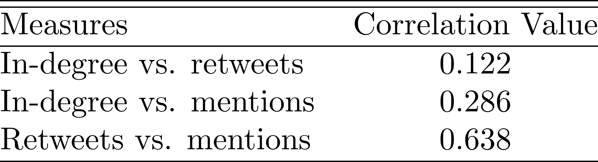
In-degrees do not carry much information
Spearman’s rank correlation is the Pearson correlation coefficient for ordinal variables that represent ranks
i.e., input range [1. . . n]
Output value is in range [-1,1]
Popular users (users with high in-degree) do not necessarily have high ranks in terms of number of retweets or mentions.

Slide 43
Influence Modeling

Slide 44
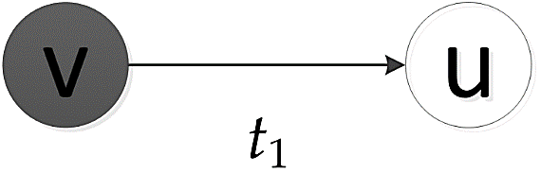
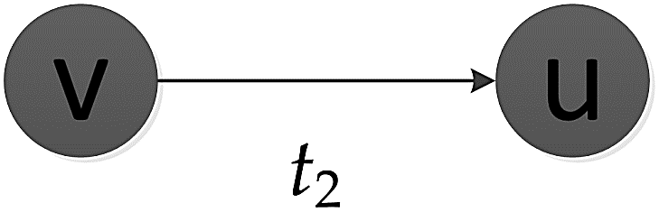
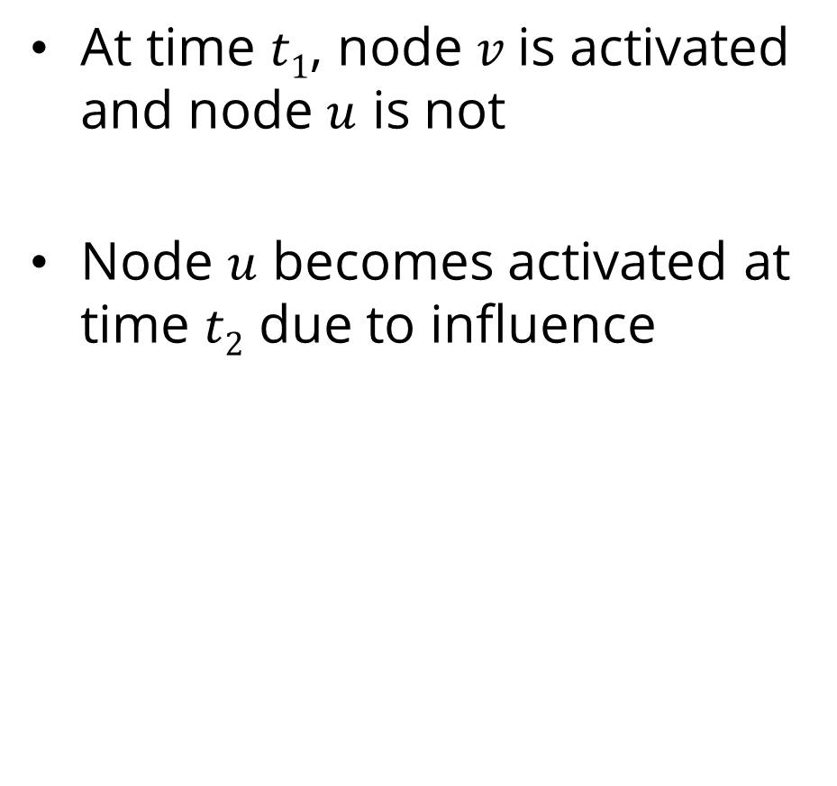
Influence Modeling
At time $t1$, node $v$is activated and node $u$ is not
Node $u$ becomes activated at time $t2$ due to influence
Each node is started as active or inactive
A node, once activated, will activate its neighbors
An activated node cannot be deactivated

Slide 45
Influence Modeling: Assumptions
The influence process takes place in a network
Sometimes this network is observable (an explicit network) and sometimes not (an implicit network).
Observable network: we can use threshold models, e.g., linear threshold model
Implicit Network: we can use methods that take the number of individuals who get influenced at different times as input, e.g., the number of buyers per week
Linear Influence Model (LIM)

Slide 46
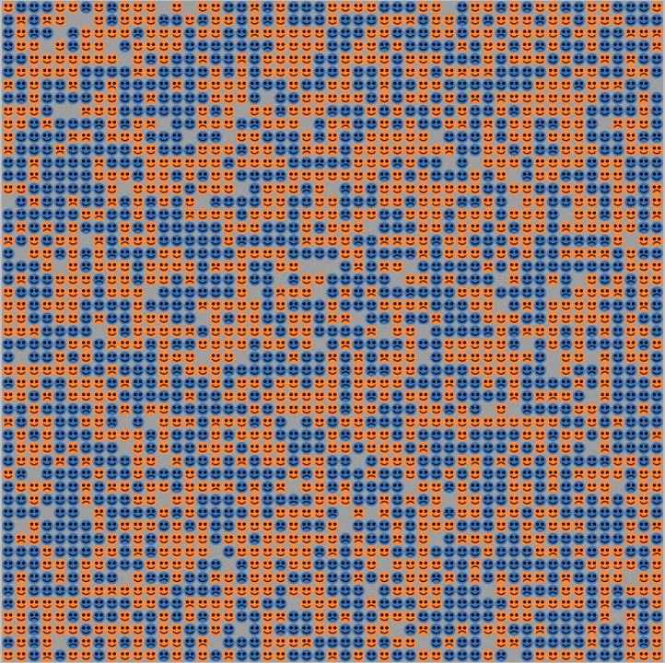
Threshold Models
Simple, yet effective methods for modeling influence in explicit networks
Nodes make decision based on the influence coming from of their already activated neighborhood
Using a threshold model, Schelling demonstrated that minor preferences in having neighbors of the same color leads to complete racial segregation
From: http://www.youtube.com/watch?v=dnffIS2EJ30

Slide 47



Linear Threshold Model (LTM)
A node $i$ would become active if incoming influence ($w_{j,i}$) from friends exceeds a certain threshold
Each node $i$ chooses a threshold $ϴi$ randomly from a uniform distribution in an interval between 0 and 1
At time $t$, all nodes that were active in the previous steps $[0..t−1]$ remain active, but only nodes activated at time $t−1$ get the chance to activate
Nodes satisfying the following condition will be activated

Slide 48

LTM Algorithm

Slide 49

Linear Threshold Model (LTM) - An Example
Thresholds are on top of nodes

Slide 50

Influence in Implicit Networks
An implicit network is one where the influence spreads over nodes in the network
Unlike the threshold model, we cannot observe users who are responsible for influencing others (the influentials), but only those who get influenced
The information available:
The set of influenced individuals at any time, $P(t)$
Time $tu$, where each individual $u$gets initially influenced (activated)

Slide 51


Influence in Implicit Networks
Assume that any influenced user $u$can influence $I(u, t)$ non-influenced users after $t$ steps
Assuming discrete time, we can formulate the size of influence population as
GOAL: estimate $I(., .)$ given activation time ($t_{u}$) and the number of influenced users at any time ($|P\left(t\right)|$)

Slide 52



The Size of the Influenced Population
Individuals $u$, $v$, and $w$are activated at time steps $tu$, $tv$, and $tw$, respectively
At time $t$, the total number of influenced individuals is the summation of influence functions $Iu$, $Iv$, and $Iw$ at time steps $t −tu$, $t−tv$, and $t−tw$, respectively
The size of the influenced population is the summation of number of users influenced by activated individuals

Slide 53


Estimating Influence Function
Estimating $I(., .)$
Parametric estimation
Use some distribution to estimate $I$ function.
Assume all users influence others in the same parametric form
For instance, one can use the power-law distribution to estimate influence:
Here we need to estimate the coefficients
Non-Parametric estimation

Slide 54


Non-Parametric Estimation
Assume that nodes can get deactivated over time and can no longer influence others.
$A(u, t)=1$ denotes that $u$ is active at time $t$
$A(u, t)=0$denotes that $u$ is either deactivated or still not influenced,
$|V|$ is the population size and $T$ is the last time step
Can be solved using non-negative least-square methods.
lsqnonneg in MATLAB

Slide 55

Homophily
“Birds of a feather flock together”

Slide 56

Definition
Homophily: the tendency of individuals to associate and bond with similar others
i.e., love of the same
People interact more often with people who are “like them” than with people who are dissimilar
What leads to Homophily?
Race and ethnicity, Sex and Gender, Age, Religion, Education, Occupation and social class, Network positions, Behavior, Attitudes, Abilities, Beliefs, and Aspirations
Notes:
From wikipedia

Slide 57



Measuring Homophily
We can measure how the assortativity of the network changes over time
Consider two snapshots of a network $G_{t}(V, E)$ and $G_{t^{′}}(V, E′)$ at times $t$ and $t′$, respectively, where $t′ > t$
$V$: fixed, $E$: edges are added/removed over time.
Nominal attributes. the Homophily index is defined as
Ordinal attributes. the Homophily index is defined as the change in Pearson correlation

Slide 58

Modeling Homophily
Homophily can be modeled using a variation of ICM
At each time step, a single node gets activated.
A node once activated will remain activated.
$Pv,w$ in the ICM model is replaced with the similarity between nodes $v$ and $w$, $sim(v,w)$.
When a node $v$ is activated, we generate a random tolerance value $θv$ for the node, between 0 and 1.
The tolerance value is the minimum similarity, node $v$requires for being connected to other nodes.
For any edge $(v, u)$ that is still not in the edge set, if the similarity $sim(v, w) >θv$, then edge $(v, w)$ is added.
This continues until all vertices are activated.

Slide 59

Homophily Model

Slide 60
Distinguishing Influence and Homophily
Shuffle Test
Edge-Reversal Test
Randomization Test
Notes:
Influence and Correlation in Social Networks, Anagnostopoulos et. Al. KDD ‘08
@inproceedings{anagnostopoulos2008influence, title={Influence and correlation in social networks}, author={Anagnostopoulos, A. and Kumar, R. and Mahdian, M.}, booktitle={Proceeding of the 14th ACM SIGKDD international conference on Knowledge discovery and data mining}, pages={7--15}, year={2008}, organization={ACM} }
@article{aral2009distinguishing, title={Distinguishing influence-based contagion from homophily-driven diffusion in dynamic networks}, author={Aral, S. and Muchnik, L. and Sundararajan, A.}, journal={Proceedings of the National Academy of Sciences}, volume={106}, number={51}, pages={21544}, year={2009}, publisher={National Acad Sciences} }

Slide 61
Distinguishing Influence and Homophily
Which social force (influence or homophily) resulted in an assortative network?
To distinguish between an influence-based assortativity or homophily-based one, statistical tests can be used
Note that in all these tests, we assume that several temporal snapshots of the dataset are available (like the LIM model) where we know exactly, when each node is activated, when edges are formed, or when attributes are changed

Slide 62


I. Shuffle Test (Influence)
IDEA:
Influence is temporal.
When $u$ influences $v$, then $u$ should have been activated before $v$.
Define a temporal assortativity measure.
If there is no influence, then a shuffling of the activation timestamps should not affect the temporal assortativity measurement.

Slide 63
Shuffle Test
If influence does not play a role, the timing of activations should be independent of users.
Even if we randomly shuffle the timestamps of user activities, we should obtain a similar temporal assortativity value
User | A | B | C
Time | 1 | 2 | 3
User | A | B | C
Time | 2 | 3 | 1
Test of Influence
After we shuffle the timestamps of user activities, if the new estimate of temporal assortativity is significantly different from the original estimate based on the user’s activity log,
there is evidence of influence.
Notes:
@inproceedings{anagnostopoulos2008influence, title={Influence and correlation in social networks}, author={Anagnostopoulos, A. and Kumar, R. and Mahdian, M.}, booktitle={Proceeding of the 14th ACM SIGKDD international conference on Knowledge discovery and data mining}, pages={7--15}, year={2008}, organization={ACM} }

Slide 64



Measuring Temporal Assortativity
Assume node activation probability depends on $a$, the number of already-active friends of the node.
Denote the probability as $p(a)$
Assume $p(a)$ can be estimated using a logistic function
$a$ is the number of active friends,
$α$ is the temporal assortativity (social correlation) : variable
$β$ is a constant to explain the innate bias for activation : variable

Slide 65


Activation Likelihood
Suppose at time $t$
$ya,t$ users with $a$ active friends become active
n_{a,t} users with $a$active friends, stay inactive
Number of users with $a$ friends activated/not-activated at any time
The probability of observing your data (likelihood function) is
Given the user’s activity log, we can compute a correlation coefficient $α$and bias $β$to maximize the above likelihood
Using a maximum likelihood iterative method

Slide 66

2. The Edge-reversal Test (Influence)
If influence resulted in activation, then the direction of edges should be important (who influenced whom).
Reverse directions of all the edges
Run the same logistic regression on the data using the new graph
If correlation is not due to influence, then $α$ should not change
C
C
A
A
B
B

Slide 67

3. Randomization Test (Influence/Homophily)
Capable of detecting both Influence and Homophily in networks
Influence changes attributes and Homophily changes connections

Slide 68

Notation and Preliminaries
$X$denotes node attributes
$X^{i}$ denotes the attributes of node $v_{i}$
$X_{t}$ denotes the attributes of nodes at time $t$
${A(G}_{t}, X_{t})$ denotes the assortativity of network $G$and attributes $X$at time $t$
The network becomes more assortative at time $t$if
$${A(G}_{t+1}, X_{t+1})−{A(G}_{t}, X_{t})>0$$

Slide 69

Influence Gain and Homophily Gain
If the assortativity is due to influence, Influence gain is positive
$$G_{Influence}(t)={A(G}_{t}, X_{t+1})−{A(G}_{t}, X_{t})>0$$
If the assortativity is due to homophily, Homophily gain is positive
$$G_{Homophily}(t)={A(G}_{t+1}, X_{t})−{A(G}_{t}, X_{t})>0$$
In randomization test, we check if these gains are significant

Slide 70

Influence Significance Test
Compute influence gain at time $t$
Denote as $g_{0}$
Compute $n$ random attributes sets for time t+1
Denote as ${XR}_{t+1}^{i}$ , $1≤i≤n$
Example.
$u$has influence over $v$.
movies is in hobbies of $u$at time $t$, but not in hobbies of $v$at time $t$.
At time $t+1$ movies is added to hobbies of v.
To remove influence effect, we can remove movies from hobbies of $v$ at time $t+1$and replace it with some random hobby (e.g., reading)
Compute the [random] influence gain for all ${XR}_{t+1}^{i}$ sets
Call them $g_{i}$
If $g_{0}$ is greater than $\left(1−\frac{α}{2}\right)\%$ of all $g_{i}$’s (or smaller than $\left(\frac{α}{2}\right)\%$ of them)
The influence gain is significant

Slide 71

Influence Significance Test

Slide 72

Homophily Significance Test
We construct random graphs, with fixed attribute sets
We remove the effect of homophily by generating $n$random graphs ${GR}_{t+1}^{i}$ at time $t+1$
For any two (randomly selected) edges $e_{ij}$ and $e_{kl}$ formed in the original graph $G_{t+1}^{}$
We form edges $e_{il}$ and $e_{kj}$
Homophily effect removed / degrees stay the same

Slide 73

Homophily Significance Test

